Slide 1

AM 801002 Capabilities for Managers
WEEK 5 Communication

Slide 2
Thought for the day
A good manager doesn’t try to eliminate conflict, he tries to keep it from wasting the energies of his people. If you’re the boss and your people fight you openly when they think that you are wrong – that’s healthy.”
(Robert Townsend)
Do you agree this statement?

Slide 3
What is conflict?
Exercise. Working in your groups (search JSTOR):
Define the terms conflict and conflict management
Find an example to illustrate this happening in the workplace.
Are managers always responsible for resolving conflict? Or is it more responsible to refer conflicts to HR personnel trained in this area?
What policies should you have in place?
How might this differ from SMEs to large organisations?
Share your findings with the class and discuss. Post your ppt on Teams.

Slide 4
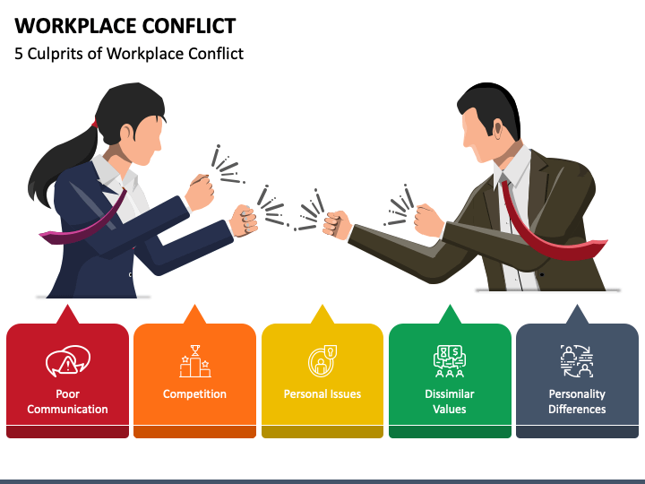

Slide 5
The conflict resolution skill set
Managers must:
Accurately assess the causes of conflict. Accurately diagnose the reasons for conflict
Select the most appropriate conflict management strategy.
Implement the correct intervention.
Apply a wide range of interpersonal skills to respond to conflict effectively.
Address obviously apparent symptoms and any underlying causes.
When behavioural skills are effectively applied, the outcome can often be a strengthened relationship between the two parties to the conflict.

Slide 6
Where does conflict come from?
Physical Conflict This can be either tangible (working conditions, infrastructure, health and safety practices etc.); or intangible (job security, remuneration disputes, seniority disagreements)
People Conflict This can often emerge from perceived or actual differences between people in terms of culture, age, gender, religious beliefs etc.
Policy and Procedural Conflict There can also be disagreements about policy and procedure, not only the ‘official’ version that may exist in a code of conduct; but also the primary symptoms of internal culture as we have already discussed
Performance Conflict This source of conflict reflects some difference of opinion in terms of the degree to which someone is performing well or not so well. This may be someone who works for you, someone who works alongside you at a similar seniority level ... or it may even be your own manager.
Any examples?

Slide 7

Activity 5.2: Debate vs. Dialogue

Slide 8
Some responses to conflict
Forcing – I win, you lose
Accommodating – you win, I lose
Avoiding – let’s not have any winners or losers
Compromising – we both win some, we both lose some
Collaborating – I win, you win

Slide 9
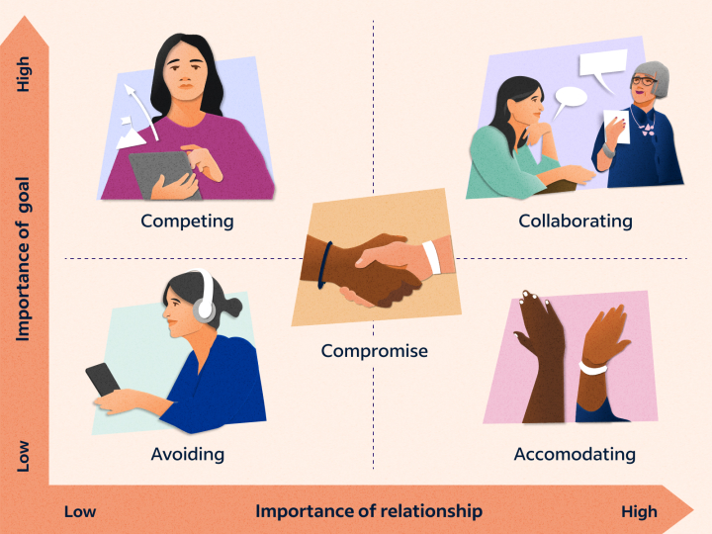

Slide 10
Some responses to conflict
What are the possible outcomes?
Which outcome solves the problem permanently?
Forcing | I win, you lose
Accommodating | You win, I lose
Avoiding | Let’s not have any winners or losers
Compromising | We both win some, we both lose some
Collaborating | I win, you win

Slide 11
How do we collaborate?
Establish shared goals, and focus on what you have in common.
Separate the people from the problem, and focus on the latter.
Focus on reasons, not demands.
Brainstorm solutions – eventually you may come up with one that is agreeable to everyone.
Move away from “what do I want?” and towards “what’s the best outcome?”.
Define success in terms of gains, not losses.

Slide 12
Communication
The ability to send messages to others that will be received, and meaning interpreted, in exactly the same manner as the sender intended.
What is the basic communication model?
How do we apply this to an organisation?

Slide 13

Activity 5.3: Barry and Communication Barriers

Slide 14
Communicating internally
Clarity of communication (or lack of it) is often a key element of internal corporate culture.
Culture is strongly influenced by management style, extent of authority delegation, importance of teamwork, stakeholder relationships, ethnic background, language, religion, country of origin and learned behaviour
Culture often exists at operating unit level – many people see themselves as “brick layers” rather than “cathedral builders.”
So managers have a significant ability to influence the culture of their organisations
Gestures Around the World (2 min) - https://www.youtube.com/watch?v=qCo3wSGYRbQ
Communicating Across Cultures (2 mins) - https://www.youtube.com/watch?v=IWq4ds-VlIo

Slide 15
An ideal world
Managers often seek an “ideal world” of employee commitment, innovative and co-operative behaviour, and ready and enthusiastic participation in teams – the idea of "one big happy family“
Three things that are needed if this is to happen:
All staff must have a clear understanding of their positioning in the organisational structure, the task structure, and the communications structure
Communications systems must operate within and between many different business units, or “islands of activity”, so communications methods need to be clear, simple and easy to understand.
The tools of communication must be installed in good time, and consistently available in fully functioning order.

Slide 16

Communication and culture
“We are living and working in a global society. Major business hubs like Dubai, Toronto, London and Hong Kong are made up of incredibly diverse workforces. As managers, we need to recognize the power and benefits of cross-cultural management. Businesses that employ people from various nationalities, working together under one roof and all facing the same, reap untold benefits from the diversity of their approach. It's important to understand that how someone approaches decisions and problem-solving could vary much based on their background, experience, traditions and culture. This brings myriad positive benefits, and it can also bring some drawbacks. Awareness of different styles of decision making can help you as a manager.”
The Importance Of Cross-Cultural Management https://www.forbes.com/sites/forbeslacouncil/2019/04/23/the-importance-of-cross-cultural-management/?sh=17c5eab51b5c

Slide 17

Language and communication
“People who speak different languages will pay attention to different things, depending on what their language usually requires them to do.”
How language shapes the way we think | Lera Boroditsky https://www.youtube.com/watch?v=RKK7wGAYP6k

Slide 18
Effective personal communication
Ensure that you communicate assertively, not aggressively
Carefully monitor body language at all times.
Ensure that all stakeholders know how to use the available communication channels.
Communicate issues to be addressed not solutions to be implemented.
Respect differing communication preferences.

Slide 19

Activity 5.4: Kenny and Hell’s Angels

